Slide 1
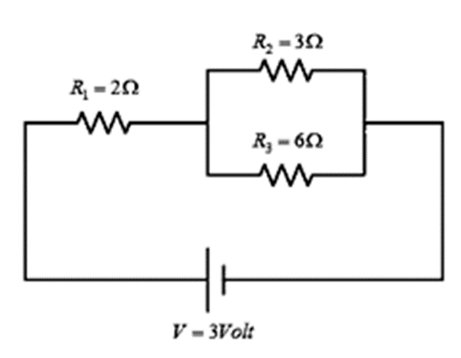
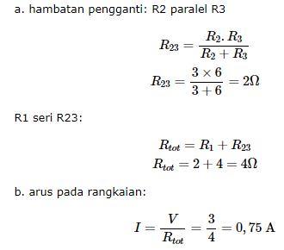
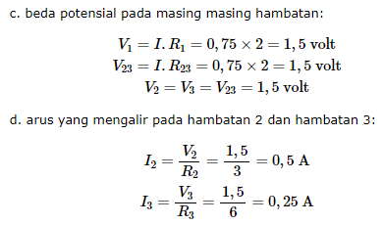
Quiz 1 (Not used in PPTI)
Design and run this simulation and answer the question. Beside your answer, attached your screen shot, output graph. Submit in .PDF format
Dari rangkaian berikut, hitung menggunakan simulasi:
Besar Arus total
Beda potensial pada masing-masing ujung hambatan
Besar arus yang melewati hambatan 2 dan hambatan 3

Slide 2
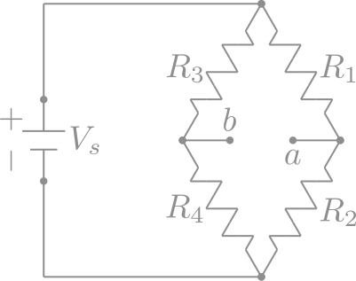
Exam Question 1:
Design and run this simulation and answer the question. Beside your answer, attached your screen shot, output graph. Submit in .PDF format
Check this web page for your reference
https://iseng-project.id/materi-fisika/sma/jembatan-wheatstone/
Create simulation based on picture on the right hand side.
Assume that your NIM is 250204ABCD.
Then, put value on R₁= A+4, R₂= B+3, R₃= C+2, R₄= D+1
Task:
Using simulation and any Voltage source and Parasitic Resistance you preferred, Calculate Equivalent Resistor (R_{eq}) and Current (I) of the circuit
How can you make the potential difference between point a and b (V_{ab}) = 0 or balanced? Proof it in through simulation if possible

Slide 3
Exam Question 2:
Design a simple RLC Rectifier I/O simulation of your own laptop in Indonesia.
What is the value of each component, so your laptop get a good and stable DC input of Voltage and Current. Check your laptop charger (AC Adaptor) for requirements.
Example: a ThinkPad X1 Carbon with 65W Charger
Indonesian standard voltage is 230V with a standard frequency of 50 Hz.
Input Charger : 100-240 V ~1.8A 50-60Hz
: calculate your peak V and R value such as in the 3rd lab
Output : 20V === 3.25A / 15V === 3A
Task:
Try to analyze the graph and explain why your simple RLC Rectifier circuit design is safe enough to be used.
Explain your step in a concise manner and a brief report with clear explanation.

